Slide 1

VAdata Tools
VAdata: Virginia’s Sexual and Domestic Violence Data Collection System

Slide 2
VAdata has several tools that make data entry easier
In this module, you will find information about:
  Selecting and managing localities
  Selecting and managing staff names
  Using the Local Only Data field on the Hotline and Advocacy Forms

Slide 3
Selecting and Managing Localities

Slide 4
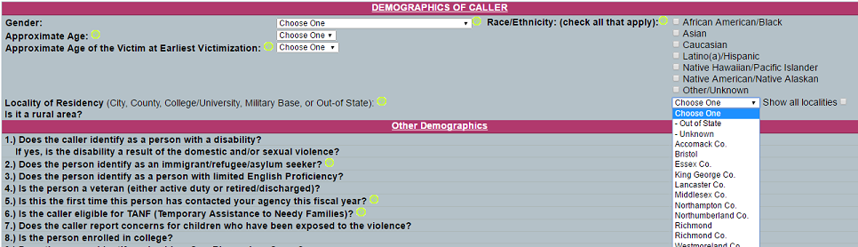
On each VAdata form, there is a drop-down box with a list of localities.
You control which localities are “automated” in the drop-down box.
Additional localities can always be accessed by clicking the ‘Show All Localities’ box.

Slide 5
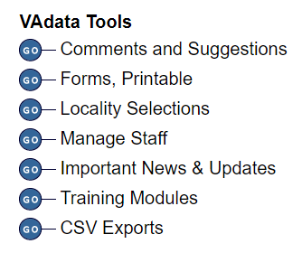
How to change the drop-down localities list:
Go to the VAdata Main Menu and select ‘Locality Selections’ in the VAdata Tools section.

Slide 6
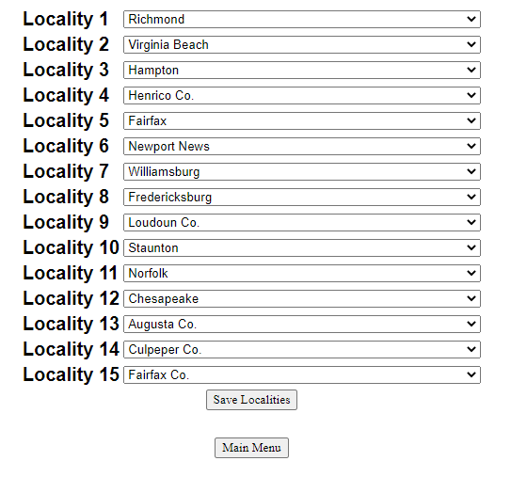
How to change the drop-down localities list:
On the next screen, you can select up to 15 localities most often served by your agency and then click the ‘Save Localities’ button.

Slide 7
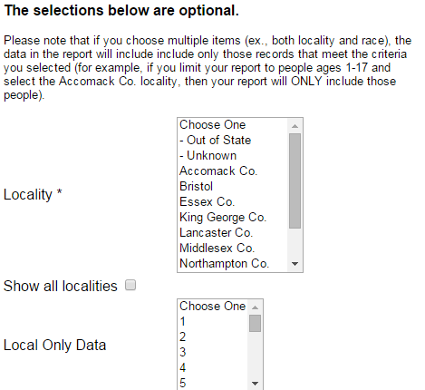
How to change the drop-down localities list:
The selected localities will appear on every drop-down locality list on VAdata forms and reports pages.
Additional localities can always be accessed by clicking the ‘Show All Localities’ box, which is also located on every form and report page.
You can change your localities list as often as you’d like, but we recommend using no more than 15 localities at any given time.

Slide 8
Selecting and Managing Staff Names

Slide 9
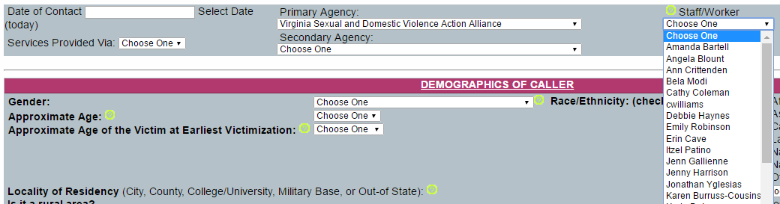
On each VAdata form, there is a drop-down box with a list of staff names.
You control which names are automated in the drop-down box.

Slide 10
How to Change the drop-down staff list:
Go to the VAdata Main Menu and select ‘Manage Staff’ in the VAdata Tools section.

Slide 11
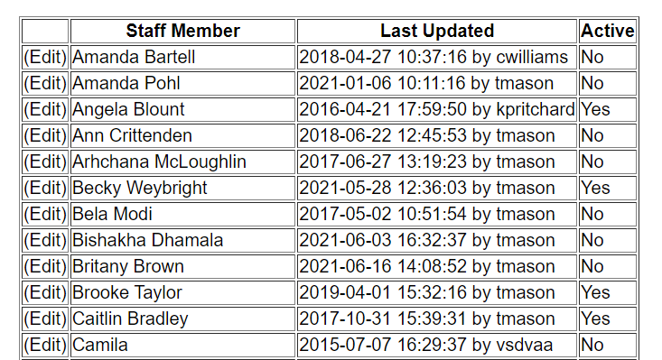
How to Change the drop-down staff list:
You will see a list of all staff names for your agency that have been created in VAdata. Note that only those names that have been designated ‘Active’ will be on the drop-down lists in the forms.

Slide 12
How to Change the drop-down staff list:
To change a status of a name from “active” to “inactive” or the reverse, click on the ‘Edit’ button.

Slide 13
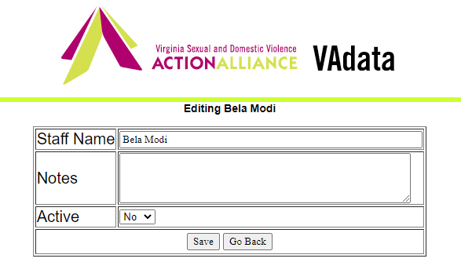
How to Change the drop-down staff list:
Select the status (Active – yes or no) and click on the ‘Save’ button.

Slide 14
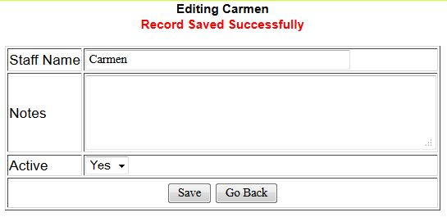
How to Change the drop-down staff list:
After you have clicked ‘Save’, you will see that the record saved successfully. Click ‘Go Back’ to edit more records or to go back to the main menu.

Slide 15
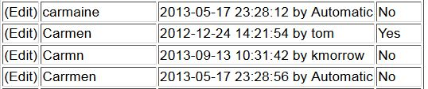
How to Change the drop-down staff list:
Some staff may have multiple variations of their names. If this is the case, you will need to decide which one you want to utilize and deactivate the others.
Do not edit the name on the drop-down list that you want to retain, just change the status of all other names and variations to ‘Active-No.’

Slide 16
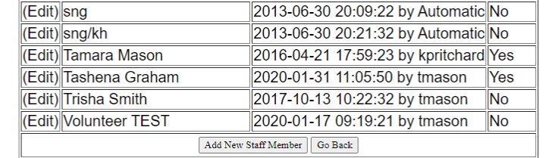
How to add a new name:
Go to the ‘Manage Staff’ page and scroll to the bottom of the list of names. Click on ‘Add New Staff Member’

Slide 17
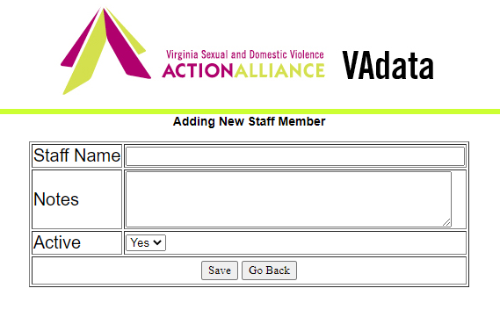
How to add a new name:
Type in the name as you want it to appear on the drop-down list, make sure that ‘Yes’ has been selected in the drop-down box by ACTIVE, and click ‘Save’.

Slide 18
How to add a new name:
After you have clicked ‘Save’, you will see that the record saved successfully. Click ‘Go Back’ to edit more records or to go back to the main menu.

Slide 19
What else can I do with this feature?
You can change the way a name appears on the drop-down list.
  For example, maybe to save time, you have always used just your first name – Felicia. What happens if another Felicia is hired? You can go to the name “Felicia” and edit it to read “Felicia Martin.” The system stores staff names as ID numbers, so it will now update all appearances of “Felicia” on past records. Then, you can add the new person, Felicia Johnson, who will have a different ID number on the back end and records will not be confused.
You can activate and de-activate names on the drop-down list. The names will remain in the system – all you have done is changed which names will appear on the short drop-down list.
You can add a “Volunteer” option on the drop-down list if your program utilizes volunteer services.
  You can run a “Summary Report by Staff” that will show how volunteers support services in your program, but it isn’t necessary to add the names of all the different volunteers unless you’d like to track data that way.

Slide 20
What else will this feature do for us?
You can run a Summary Report by Staff.
This report includes the following data broken down by staff name:
  Number and total hours of Hotline contacts
  Number of people, number of contacts, and total hours provided to clients via Advocacy services
  Number Community Engagement activities

Slide 21
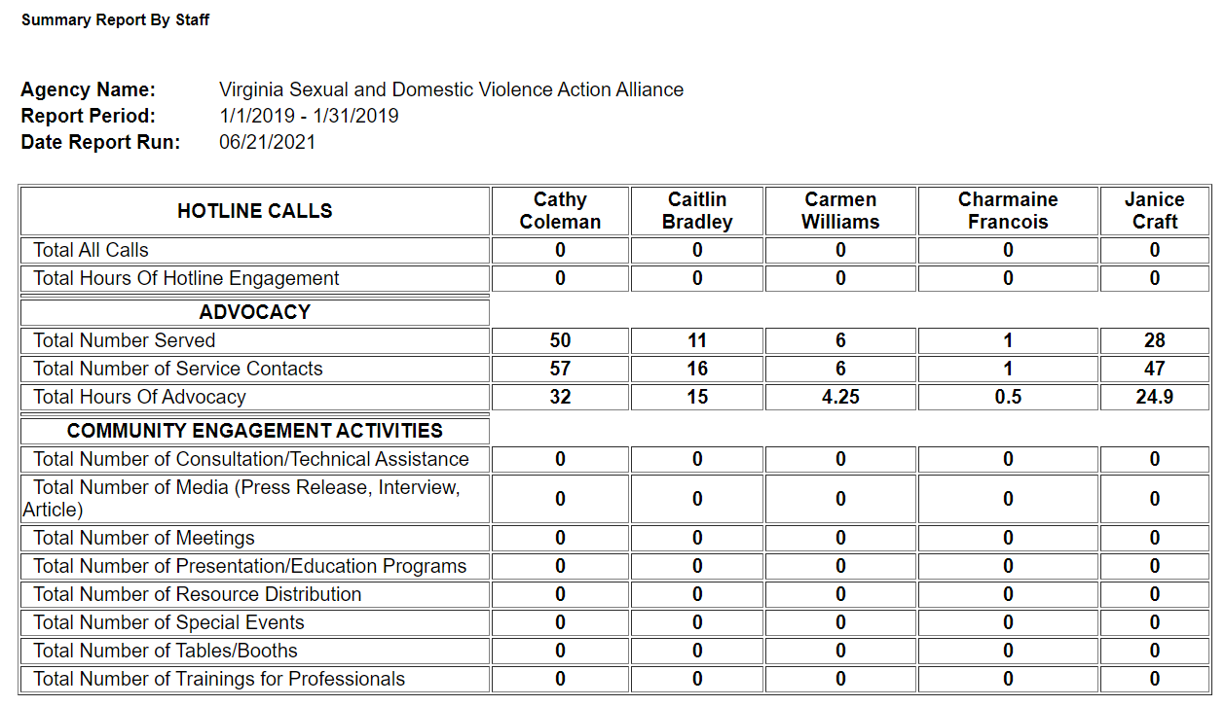
Sample Summary Report By Staff

Slide 22
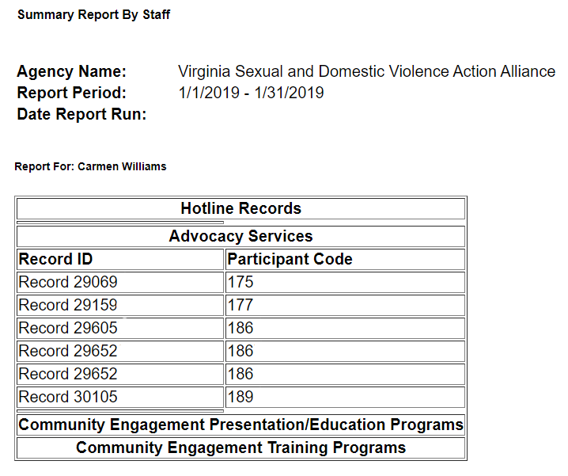
Sample Summary Report By Staff
Click on any staff name and a list of records attributed to that person will appear.
Then, click on any record number to go to that record.

Slide 23
What Happens If I don’t Update my Staff list?
Nothing!
This feature is used to improve your ability to query by staff and to enable you to run a report by staff without having to sift through dozens of names. For ease of use, it is recommended to periodically update your staff lists, but it isn’t required.
These changes will not delete any data from VAdata or impact current reports.
If you choose not to clean up the staff data, however, you may encounter errors when querying by staff or if you want to run a report by staff.

Slide 24
A Note About Queries:
Previously, users had the ability to enter their name into a text box, meaning that some staff may have used multiple variations of their name when entering data (i.e. Kristen, Kristen P., Kris). Because of this, queries by staff name for data entered prior to July 1, 2013 may still be a bit cumbersome.
If you would like to query by staff name for data entered prior to July 1, 2013, you may need to “Activate” the old variations of names and do multiple queries.
It is much easier to use the query function for data entered after July 1, 2013 because users were required to choose and only use ONE variation of their name.

Slide 25
Local Only Data field on the
Hotline and Advocacy Forms

Slide 26
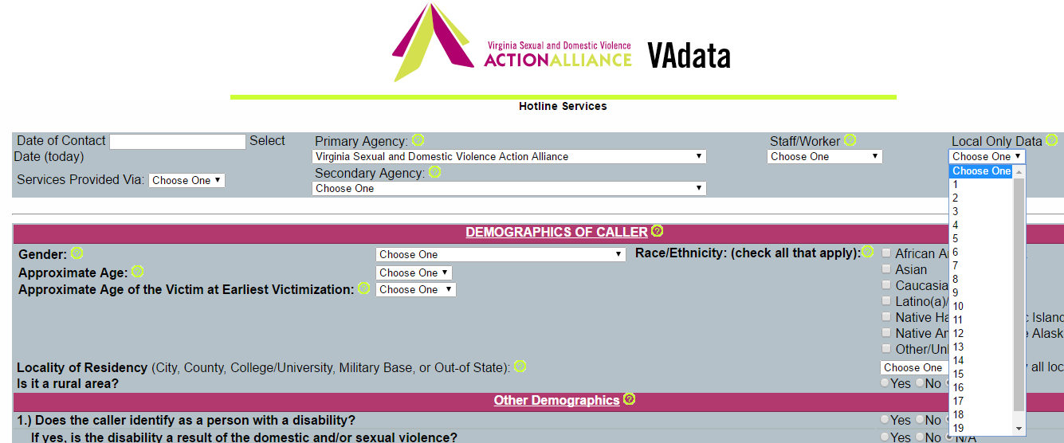
Local Only Data
On the Hotline and Advocacy forms, you will see a field labeled Local Only Data. In this field, you can set a number from 1-20 to “flag” a record. This is a totally optional field, and you may choose never to use it.
The value/meaning of the numbers is held only by your agency, so you may choose to use this field to track specific data of importance to your agency and/or community.

Slide 27

How to use the local only data field:
Decide what data you want to track and how you might “code” that data in a numeric (1-20) format.
  For example, if you want to collect data on the zip codes where hotline callers reside, you could designate zip code 23230 as “1”, 23832 as “2”, and so on, using up to the 20 options available.
  As another example, you might want to use this field to track a demographic about survivors that isn’t current captured but is valuable to your agency and services, such as HIV or marital status.
Communicate this system to everyone using the Hotline and Advocacy forms how to “code” the data.

Slide 28
What are some examples of data we could collect?
You could collect data about
  calls received as a result of a particular public awareness campaign,
  a particular demographic that is not already collected in VAdata,
  a local or currently untracked funding source (which would give you the ability to run a report on services for that funding source),
  particular zip codes, neighborhoods, or other “communities” within your service area.
The possibilities are only limited by the numeric options (1-20) and your imagination. Remember, the VAdata staff are always happy to assist you with data collection design!

Slide 29
How could this be helpful?
You can query on this field.
The Hotline and Advocacy Data Reports can be run for a particular number or set of numbers from the Local Only Data fields.
Feel free to ask the VAdata staff about how other agencies have chosen to use this field and how it could be useful for your own tracking and reporting.

Slide 30
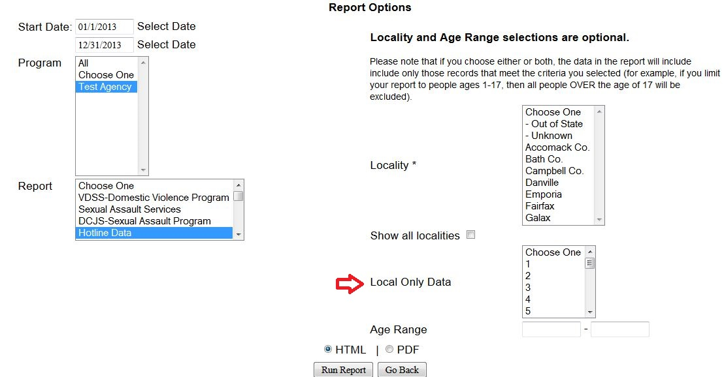
How do I run a report to reflect the Local Only data?
From the Reports screen, select the Hotline or Advocacy Data report and enter the Local Only data you want to review.

Slide 31

Help Options
You may note this symbol by several fields on the form:
Click on the symbol for more detailed information or requirements of the field.

Slide 32
HELP! VAdata’s not working.
If you think something is wrong with VAdata, please let us know! Give us a call at 804.377.0335 OR email us at vadataadmin@vsdvalliance.org.
We don’t use VAdata in the same ways you do, so sometimes the only way that we know something is off or broken is when you tell us.
We also like to talk with you by phone when you have questions, because we usually want information that you might not know we need.

Slide 33
How Can I Get Additional Help About Other Topics or Concerns?
The Action Alliance staff urge you to contact us whenever you have a question or a concern about VAdata, resources, advocacy, policy, training, funding, or anything else.
Staff can be reached at
804.377.0335
Or you can visit our website to send a message directly to staff members. Visit https://vsdvalliance.org/contact/.

